Slide 2
Taming Unbounded Resources with Node Feature Discovery
Mark Abrams
Notes:
First of all, I just want to take a minute to say that the edge means different things to different stakeholders.
For some, the edge is the edge of the cloud - call it a silver lining if you like
In this presentation, I am talking about the edge beyond the silver lining. I’m looking at the vast blue skies beyond the clouds
For example
Factories
Retail
Energy
Automotive and Aerospace
Smart cities
Devices here are at the edge of the network. The leaf nodes
With that, lets take a look at Node Feature Discovery

Slide 3
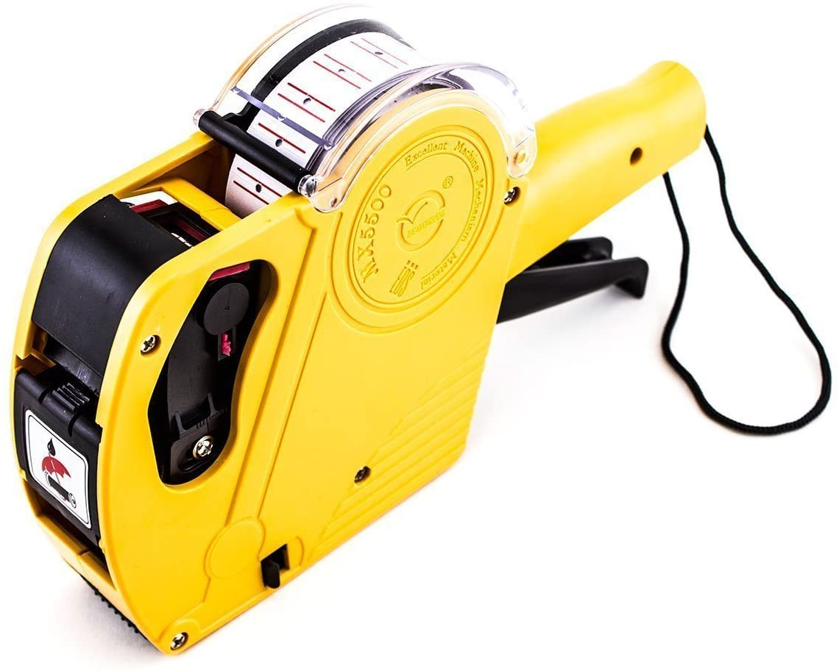
What is Node Feature Discovery (NFD)
NFD is simply a fancy labeler
K8s node labels

Slide 4

Why do I need a labeler
Mapping workloads to appropriate resources
Resources
Workloads
Notes:
I think the number one value is for the ease of mapping workloads to resources

Slide 5
Why do I need a labeler
Because we are delivering cattle not pets
Volume - a large number of devices
Efficiency
Accuracy
Resources at the Edge
Are not just CPU and RAM
Are Unbounded
Notes:
Automating work is what we do
With massive numbers of devices, we need to get it right.
Automated labeling can be a great time saver for large numbers of devices
The resource types we are targeting don’t fall neatly into the CPU and RAM category
Edge resource capabilities are unbounded

Slide 6
Unbounded Resources?
K8s is designed to schedule workloads against resources
In the data center (first class features of k8s)
CPU
RAM
GPU
At the edge (not schedulable by default)
Unlimited number of I/O devices are possible
Sensors
Actuators
Notes:
What do I mean by unbounded resources?
I say unbounded because they are not infinite, but there is really no limit to what device might be attached to your node.
Within your individual use case, there is a finite set of target resources. That’s good.
- NFD labels can be used to classify and give logical boundaries relevant to each enterprise
At the edge, resource examples are
USB
GPU
NIC
FPGA
Video IN/OUT
Radios (LoRA/BLE/WiFi)
I2C or other Serial interfaces
ETC.

Slide 7


w/o NFD - Childs Play
Do you have any 3’s
Go fish
Notes:
Without NFD and large numbers of clusters it is like playing a game of go fish.
I don’t know if you are familiar with this game
basically you take turns with your opponents asking if they have the resource you need
it’s a guessing game
In the real world, you shouldn’t just guess which devices have the right resources
NFD takes the guesswork out of it

Slide 8
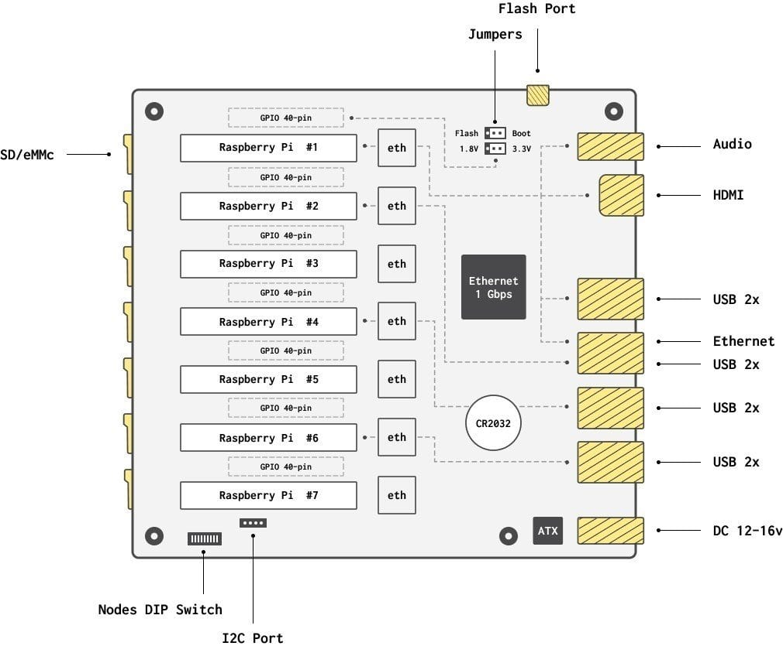
Demo Infrastructure - turingpi v1
7 RaspberryPi CM3+ modules
1GB RAM
4 CPU
8 USB ports
Map to only 4 devices
I2C interface
Maps to all devices
Communication between devices
GPIO
40 pins for each device

Slide 9
Demo Infrastructure - turingpi v1
7 RaspberryPi CM3+ modules
1GB RAM
4 CPU
8 USB ports
Map to only 4 devices
I2C interface
Maps to all devices
Communication between devices
GPIO
40 pins for each device
Notes:
This is a turingpi v1 board
It has 7 raspberry pi compute modules
Each module is a version 3 plus with 1 gig RAM and 4 CPU per device
On device node 7, I run the master and the remaining 6 devices are workers.

Slide 10
Demo Infrastructure - turingpi v1
7 RaspberryPi CM3+ modules
1GB RAM
4 CPU
8 USB ports
Map to only 4 devices
I2C interface
Maps to all devices
Communication between devices
GPIO
40 pins for each device
7
1
Hostname: turingpi02
2
3
4
5
6
Notes:
Node numbers and names do not match up with the device numbers in this diagram.

Slide 11
Demo Infrastructure - turingpi v1
7 RaspberryPi CM3+ modules
1GB RAM
4 CPU
8 USB ports
Map to only 4 devices
I2C interface
Maps to all devices
Communication between devices
GPIO
40 pins for each device

Slide 12
Demo Infrastructure - turingpi v1
7 RaspberryPi CM3+ modules
1GB RAM
4 CPU
8 USB ports
Map to only 4 devices
I2C interface
Maps to all devices
Communication between devices
GPIO
40 pins for each device

Slide 13
Demo Infrastructure - turingpi v1
7 RaspberryPi CM3+ modules
1GB RAM
4 CPU
8 USB ports
Map to only 4 devices
I2C interface
Maps to all devices
Communication between devices
GPIO
40 pins for each device

Slide 14
Demo Infrastructure - turingpi v1
7 RaspberryPi CM3+ modules
1GB RAM
4 CPU
8 USB ports
Map to only 4 devices
I2C interface
Maps to all devices
Communication between devices
GPIO
40 pins for each device

Slide 15
Demo
Notes:
I’d like to show you Node Feature Discovery in action. So, let’s have a short demo.

Slide 16
How does it work
Two Kubernetes Resources
NFD Master (Deployment)
NFD Worker (DaemonSet)
Notes:
Very simply
NFD-Master is a Deployment and it is responsible for communication towards the Kubernetes API. That is, it receives labeling requests from the worker and modifies node objects accordingly.
NFD-Worker is a DaemonSet and it is responsible for feature detection. It then communicates the information to nfd-master which does the actual node labeling.

Slide 17
How does it work
Operations team responsibilities
Know your devices
Create configuration defining known resources
NFD does the rest

Slide 18
Install Node Feature Discovery
CRDs
K8s templates (yaml config)
Helm Chart
Operator
NFD does what it does based on a configuration file
Configmap is the key to the labeling
Notes:
Actually you can pass arguments to the worker container using the --config flag. When the underlying configmap changes, the worker reloads it.

Slide 19
Example ConfigMap
#core:
# labelWhiteList:
# noPublish: false
# sleepInterval: 60s
# sources: [all]
# klog:
# addDirHeader: false
# alsologtostderr: false
# logBacktraceAt:
# logtostderr: true
# skipHeaders: false
# stderrthreshold: 2
# v: 0
# vmodule:
# logDir:
# logFile:
# logFileMaxSize: 1800
# skipLogHeaders: false
sources:
# cpu:
# cpuid:
## NOTE: whitelist has priority over blacklist
# attributeBlacklist:
# - "BMI1"
# attributeWhitelist:
# kernel:
# kconfigFile: "/path/to/kconfig"
# configOpts:
# - "NO_HZ"
# - "X86"
# - "DMI"
usb:
deviceClassWhitelist:
- "03"
deviceLabelFields:
- "class"
- "vendor"
- "device"
Notes:
This is pretty simple, I run NFD with my unique configuration and labeling happens.
There is one small issue.
Operations that are managing 100s or thousands of devices, also periodically add, remove or update their systems.
Now my configuration has to change accordingly or else I need to start managing multiple versions of it.
Which would you rather do:
Manage one config map or
Manage the management of multiple configmaps.
To illustrate why I’m asking this question, let’s do a quick review of edge architectures.

Slide 20

Practicatl NFD - Architecture Review
Data Center / Cloud
dev
test
staging
prod
Notes:
Red lines represent the cluster boundaries.
This is a typical scenario in cloud and data centers
My little cluster represents something akin to one of these environments
In the real world however, Kubernetes at the edge is not composed of environments with highly available clusters

Slide 21
Practicatl NFD - Architecture Review
Data Center / Cloud
dev
test
staging
prod
Edge - Its all production
Notes:
Compare the data center with the edge scenario
There are only 32 clusters in the edge image you see here
so we’re talking easily 10 or 100x this visual representation for some enterprise edge deployments
Now, in your mind, add and remove a few clusters at the edge - let the clusters be ephemeral
This is the practical implication of edge kubernetes
So, what changed on the new devices you added,
Go Fish?
I don’t think so
So, I ask again, At the Edge
Which would you rather do:
Manage one config map or
Manage the management of multiple configmaps.
The extent of NFD at the edge requires a higher level of management

Slide 22
GitOps for Apps and NFD at the Edge
NFD Topics for another day
Rancher Fleet
Argo CD
Flux
Notes:
Hopefully you chose to manage one single configuration.
Of these 3 tools, I am really only familiar with Fleet
In Fleet, it is possible to manage large numbers of clusters and target workloads and custom configs to the clusters based on matching.
One gap still here is that we do not have an auto cluster labeler.
Cluster is a CRD in fleet but not in Kubernetes. That means each gitops tool may be offering a different solution for centralized node label management
I think the Kubernetes SIG Cluster API may hold the answer.

Slide 23
Example gitops workflow
Install NFD via the gitops pipeline into every cluster
Setup NFD configmap and commit to pipeline
The clusters manager should automatically
recognize changes in downstream cluster node labels and
update the cluster labels accordingly
Notify developers
of the node labels available
and what resource it maps to
Repeat steps 2 - 4 on changes, hardware updates, etc.
Notes:
Here is what I envision the gitops pipeline
First install NFD using the gitops pipeline itself.
Second - Of course, setup your configuration.
Number 3 is a passive stakeholder however it will impact how the gitops tooling targets devices - At least with Fleet, this is how it works.
Finally, notify developers what labels they should target resources using nodeSelectors

Slide 24
Security
Mutual TLS capable between nfd-master and nfd-worker
Risk: Allowing Local - user specific features
will execute arbitrary files located in
/etc/kubernetes/node-feature-discovery/source.d on the host
Limit features discovered by specifying exact sources
Whilelist/Blacklist features
nfd-worker.conf:
set only specific sources
e.g. sources: [usb,custom,local]
Notes:
It is possible to configure TLS between the NFD services
There is a security risk in the local feature functionality as it will execute any script or binary in that directory
of course this is inside the container
You could reduce the footprint of feature capabilities by configuration
The Fleet tooling enables the ability to send different configurations from a single source to different targets

Slide 25
NFD Summary
Label nodes in a cluster
Label one cluster at a time
The edge will be thousands of single node or small clusters
External tooling is needed to find groups of the same feature (gitops)
Feature discovery can be specified via configuration file
Limited features types
Non kernel module features can be added using the local option
Compare with Kubernetes device plugins

Slide 26
NFD Summary
NFD allows drop in configmaps to another location
Vendors can/should provide configs for their devices
NVIDIA does this with the GPU Operator already
NFD is not “just” a labeler.
It is a dynamic labeler
It is a configurable labeler

Slide 27
NFD Summary - Pitfalls
Kernel module existence is not a guarantee of functionality
Kernel models can be loaded that have no physical counterpart
K8s health checks may add value here
Hot plugging devices works but it is not immediate
Kubernetes will need some cycles to label
Re-labeling may also require redeployment of workloads

Slide 28
Links
https://kubernetes-sigs.github.io/node-feature-discovery/v0.8/get-started/
https://kubernetes-sigs.github.io/node-feature-discovery/v0.8/get-started/features.html
https://www.usb.org/defined-class-codes
https://k3s-io/k3s
https://github.com/mak3r/nfd-demo

Slide 29
Thank you
Mark Abrams - Field Engineer and Edge Specialist SUSE
Notes:
I contribute to open source and you can too.
Thank you

Slide 30
Setting up USB detection
Configmap now has
feature.node.kubernetes.io/usb-ff_0424_ec00.present:true
Notes:
Notice, on the first output line, that’s the Ethernet adapter.
This is a turingpi with 7 RasberryPi CM3+ modules attached.
Let’s see if we can detect something plugged into one of the hubs on device 002 or 001

Slide 31
Setting up USB detection
Turingpi v1
Notes:
Here’s a diagram of the device.
My master node is on the last one labeled #7 in this diagram
I plugged a device into the usb port that’s connected to #4 (which is named turingpi03 in my cluster)

Slide 32
Setting up USB detection
Turingpi v1

Slide 33
Setting up USB detection
cluster node 3
markabrams@mak3r:~/dev/nfd-demo$ ssh tp3 lsusb
Warning: Permanently added the ECDSA host key for IP address 'fe80::d6d1:e799:44cf:e359%en13' to the list of known hosts.
Bus 001 Device 004: ID 0c45:7603 Microdia
Bus 001 Device 003: ID 0424:ec00 Standard Microsystems Corp. SMSC9512/9514 Fast Ethernet Adapter
Bus 001 Device 002: ID 0424:9514 Standard Microsystems Corp. SMC9514 Hub
Bus 001 Device 001: ID 1d6b:0002 Linux Foundation 2.0 root hub
markabrams@mak3r:~/dev/nfd-demo$ ssh tp6 lsusb
Bus 001 Device 003: ID 0424:ec00 Standard Microsystems Corp. SMSC9512/9514 Fast Ethernet Adapter
Bus 001 Device 002: ID 0424:9514 Standard Microsystems Corp. SMC9514 Hub
Bus 001 Device 001: ID 1d6b:0002 Linux Foundation 2.0 root hub
Notes:
Comparing it to the other node we looked at,
we can see now a microdia device

Slide 34
Setting up USB detection
cluster node 3 - usb labels
feature.node.kubernetes.io/usb-ff_0424_ec00.present:true
Notes:
But it still doesn’t show up as a label on our node
Let’s find out the configuration we need to set up

Slide 35
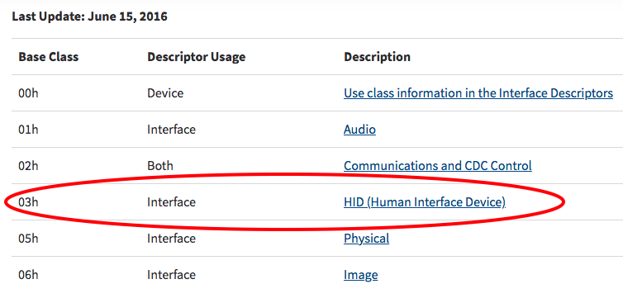
Setting up USB detection
Class=Human Interface Device
https://www.usb.org/defined-class-codes
markabrams@mak3r:~/dev/nfd-demo$ ssh tp3 lsusb -t
/: Bus 01.Port 1: Dev 1, Class=root_hub, Driver=dwc_otg/1p, 480M
|__ Port 1: Dev 2, If 0, Class=Hub, Driver=hub/5p, 480M
|__ Port 1: Dev 3, If 0, Class=Vendor Specific Class, Driver=smsc95xx, 480M
|__ Port 3: Dev 4, If 0, Class=Human Interface Device, Driver=usbhid, 1.5M
|__ Port 3: Dev 4, If 1, Class=Human Interface Device, Driver=usbhid, 1.5M
Notes:
We need more info and we’ll cross reference the device specs at usb.org
hex 03 is what we’re looking for.

Slide 36
Setting up USB detection
Default for usb configuration in NFD
# usb:
# deviceClassWhitelist:
# - "0e"
# - "ef"
# - "fe"
# - "ff"
# deviceLabelFields:
# - "class"
# - "vendor"
# - "device"

Slide 37
Setting up USB detection
Modified usb configuration in NFD
usb:
deviceClassWhitelist:
- "03”
# - ”0e"
# - "ef"
# - "fe"
# - "ff"
deviceLabelFields:
- "class"
- "vendor"
- "device"
Notes:
I do not know how it found the USB ethernet device

